Slide 1
Textual visualization & analysis in Greek, latin & beyond
Eleni Bozia, Ph.D., Dr. Phil.
Assistant Professor
Department of Classics
University of Florida
SunoikisisDC Digital Classics
Summer Semester
June 18th, 2020

Slide 2
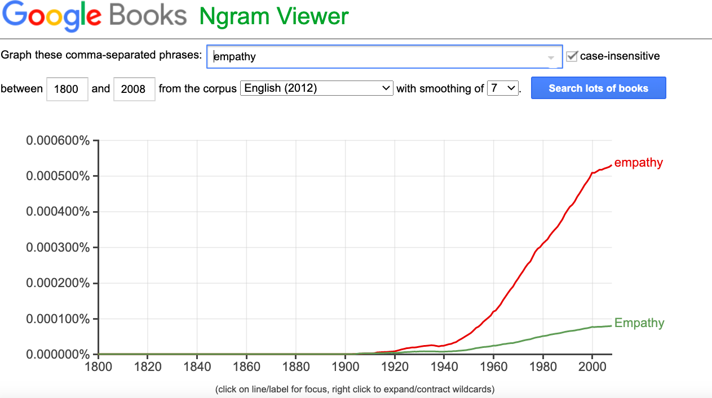
Textual analysis is a methodology that involves understanding language, symbols, and/or pictures present in texts to gain information regarding how people make sense of and communicate life and life experiences. Visual, written, or spoken messages provide cues to ways through which communication may be understood.

Slide 3
Society and textual analysis

Slide 4

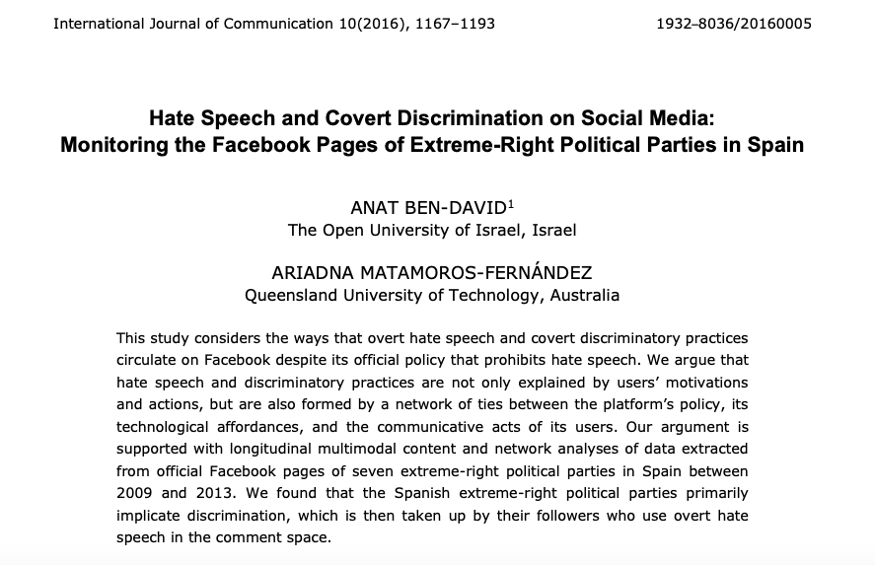
Politics of language

Slide 5
Text analysis & visualization
http://www.online-utility.org/text/analyzer.jsp
https://www.jasondavies.com/wordcloud/#
www.wordsift.com
www.infranodus.com
http://voyant-tools.org/tool/Bubbles/

Slide 6
References
The Historian’s Macroscope: Big Digital History
Introduction to Visualization
Practical Issues in Visualization

Slide 7
1001 'Greatest' Movies of All Time

Slide 8
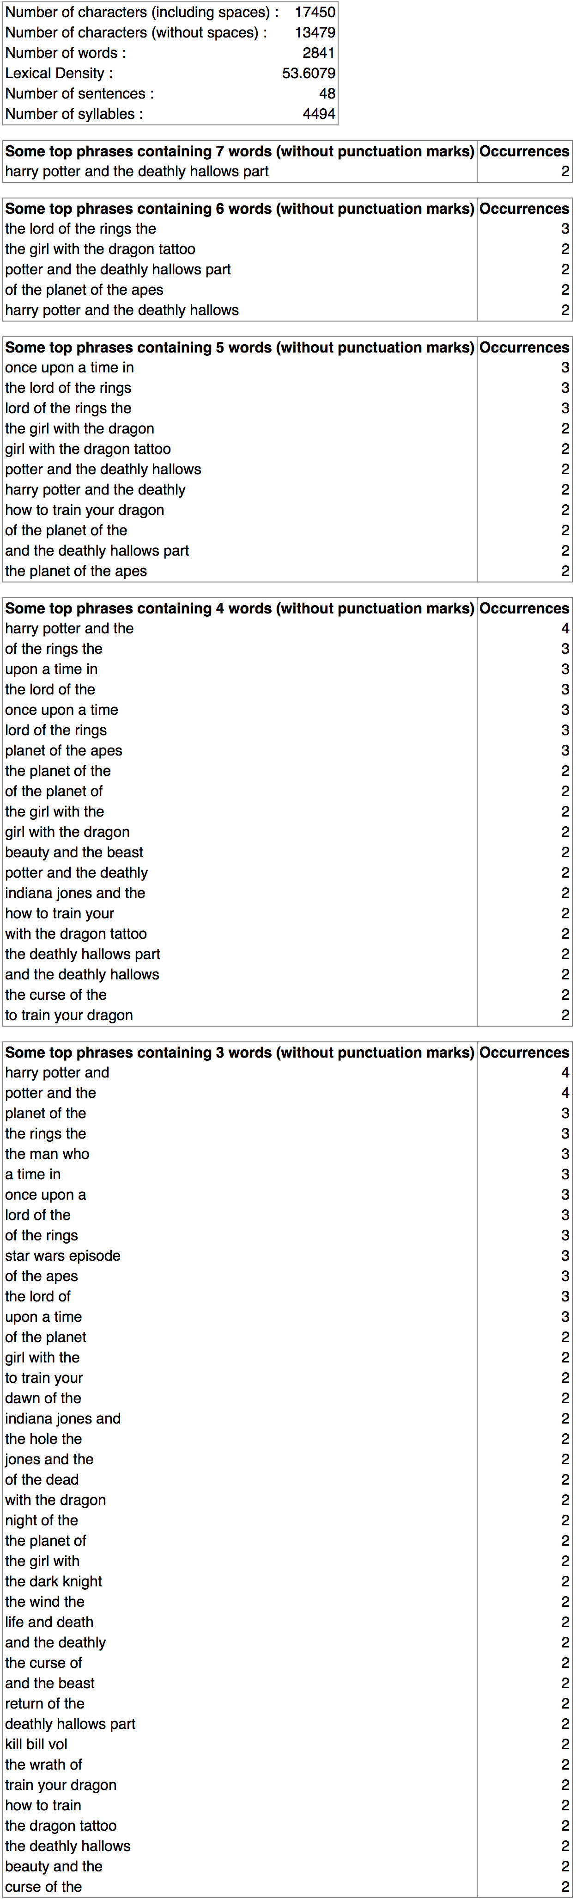

Slide 9
Most frequent words in the corpus:
man (24);
day (10);
life (10);
night (10);
dead (8)

Slide 10
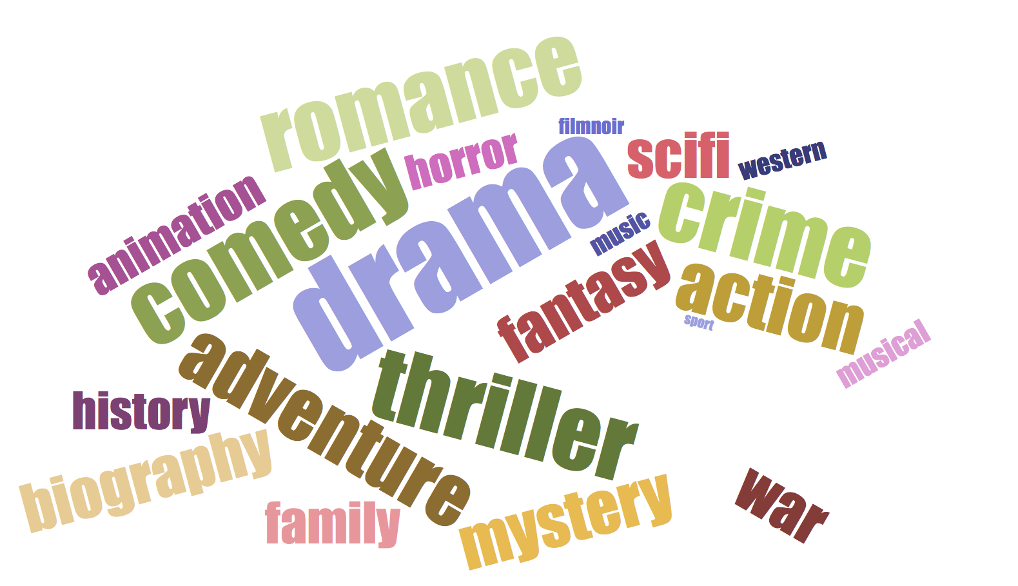
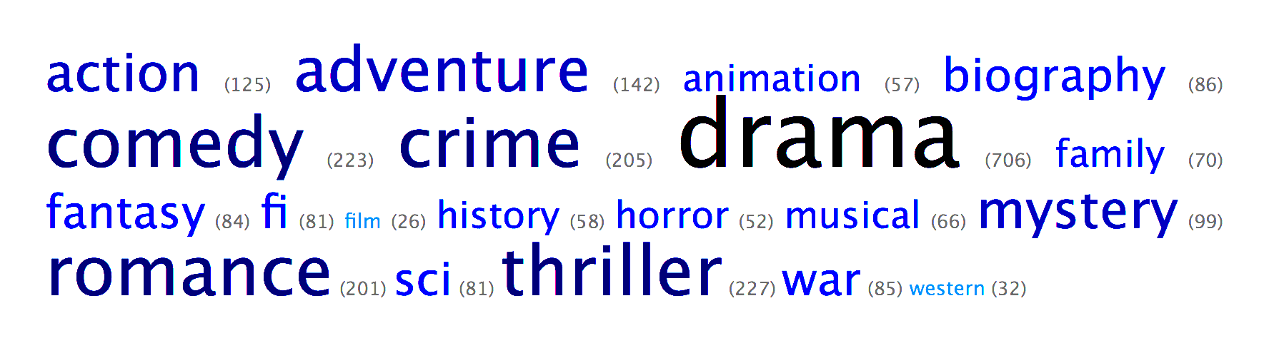
Genres Analysis

Slide 11
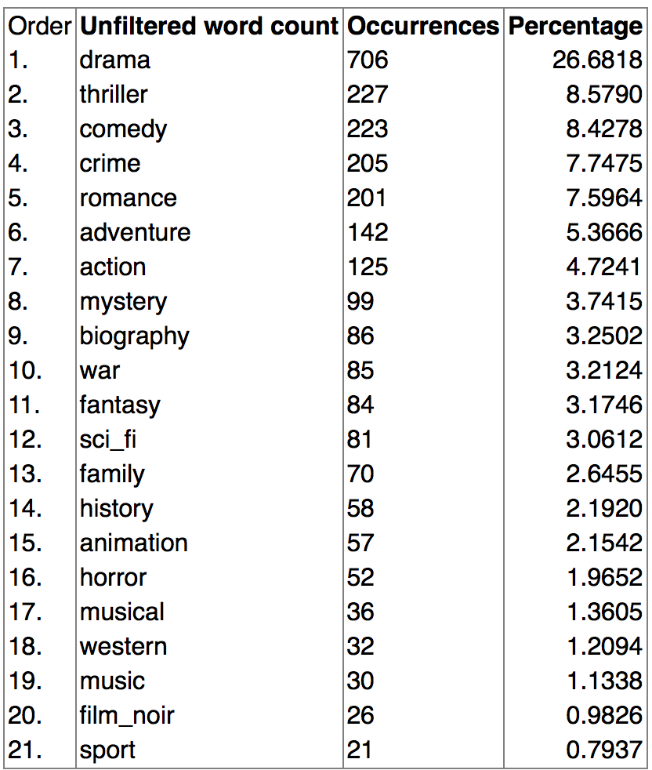

Slide 12
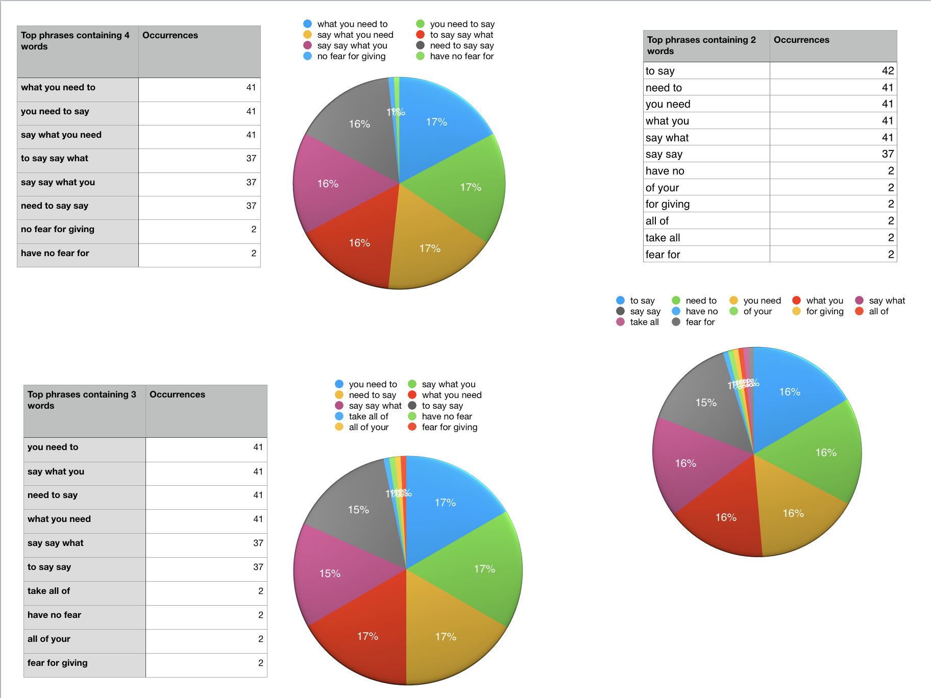
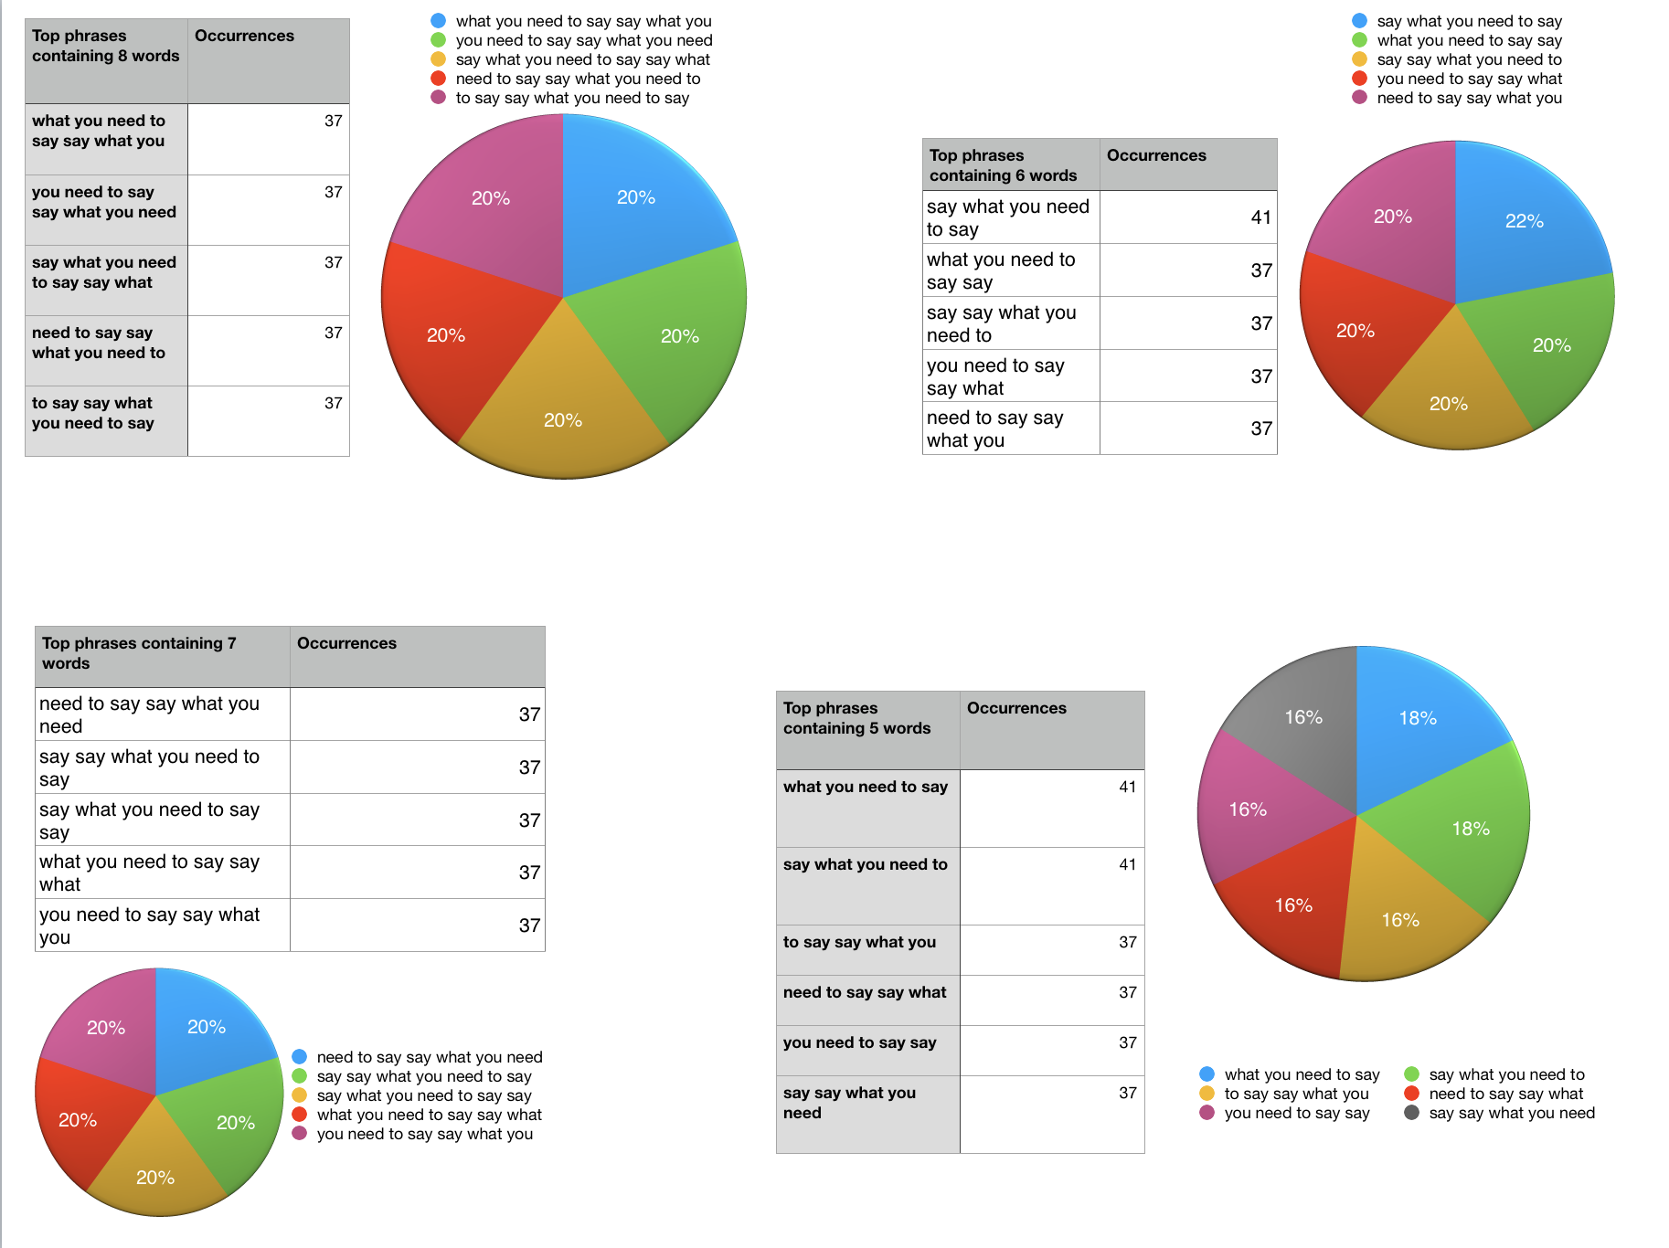
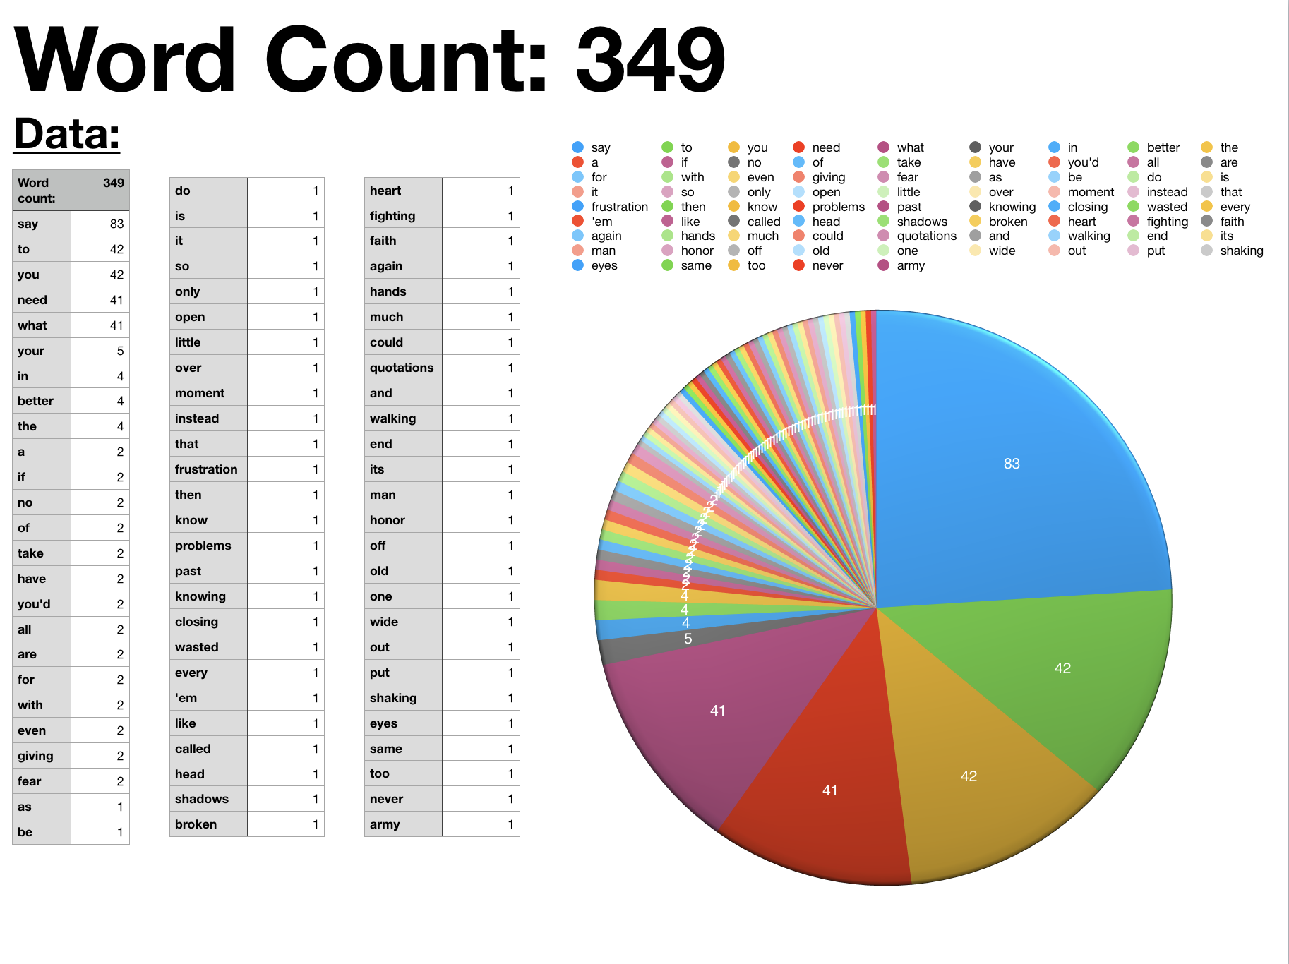
Say What you
need to say:

Slide 13
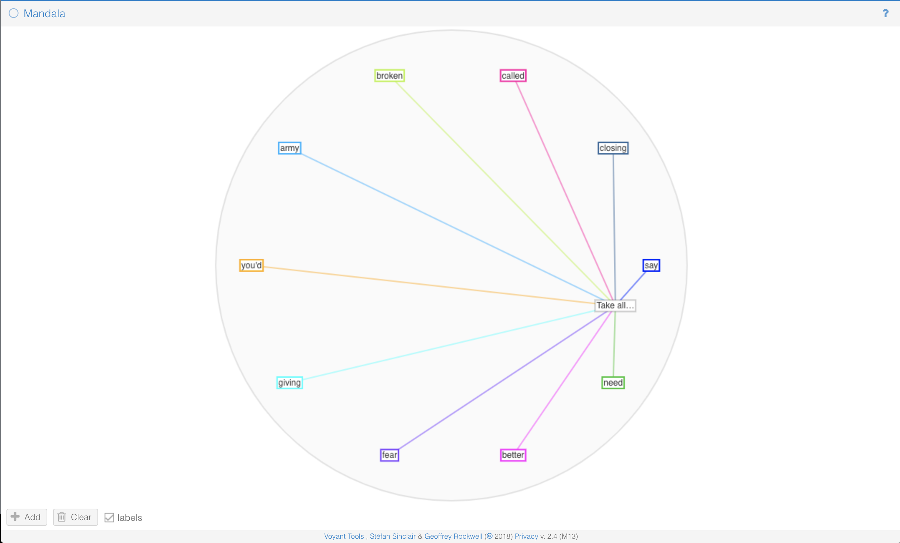
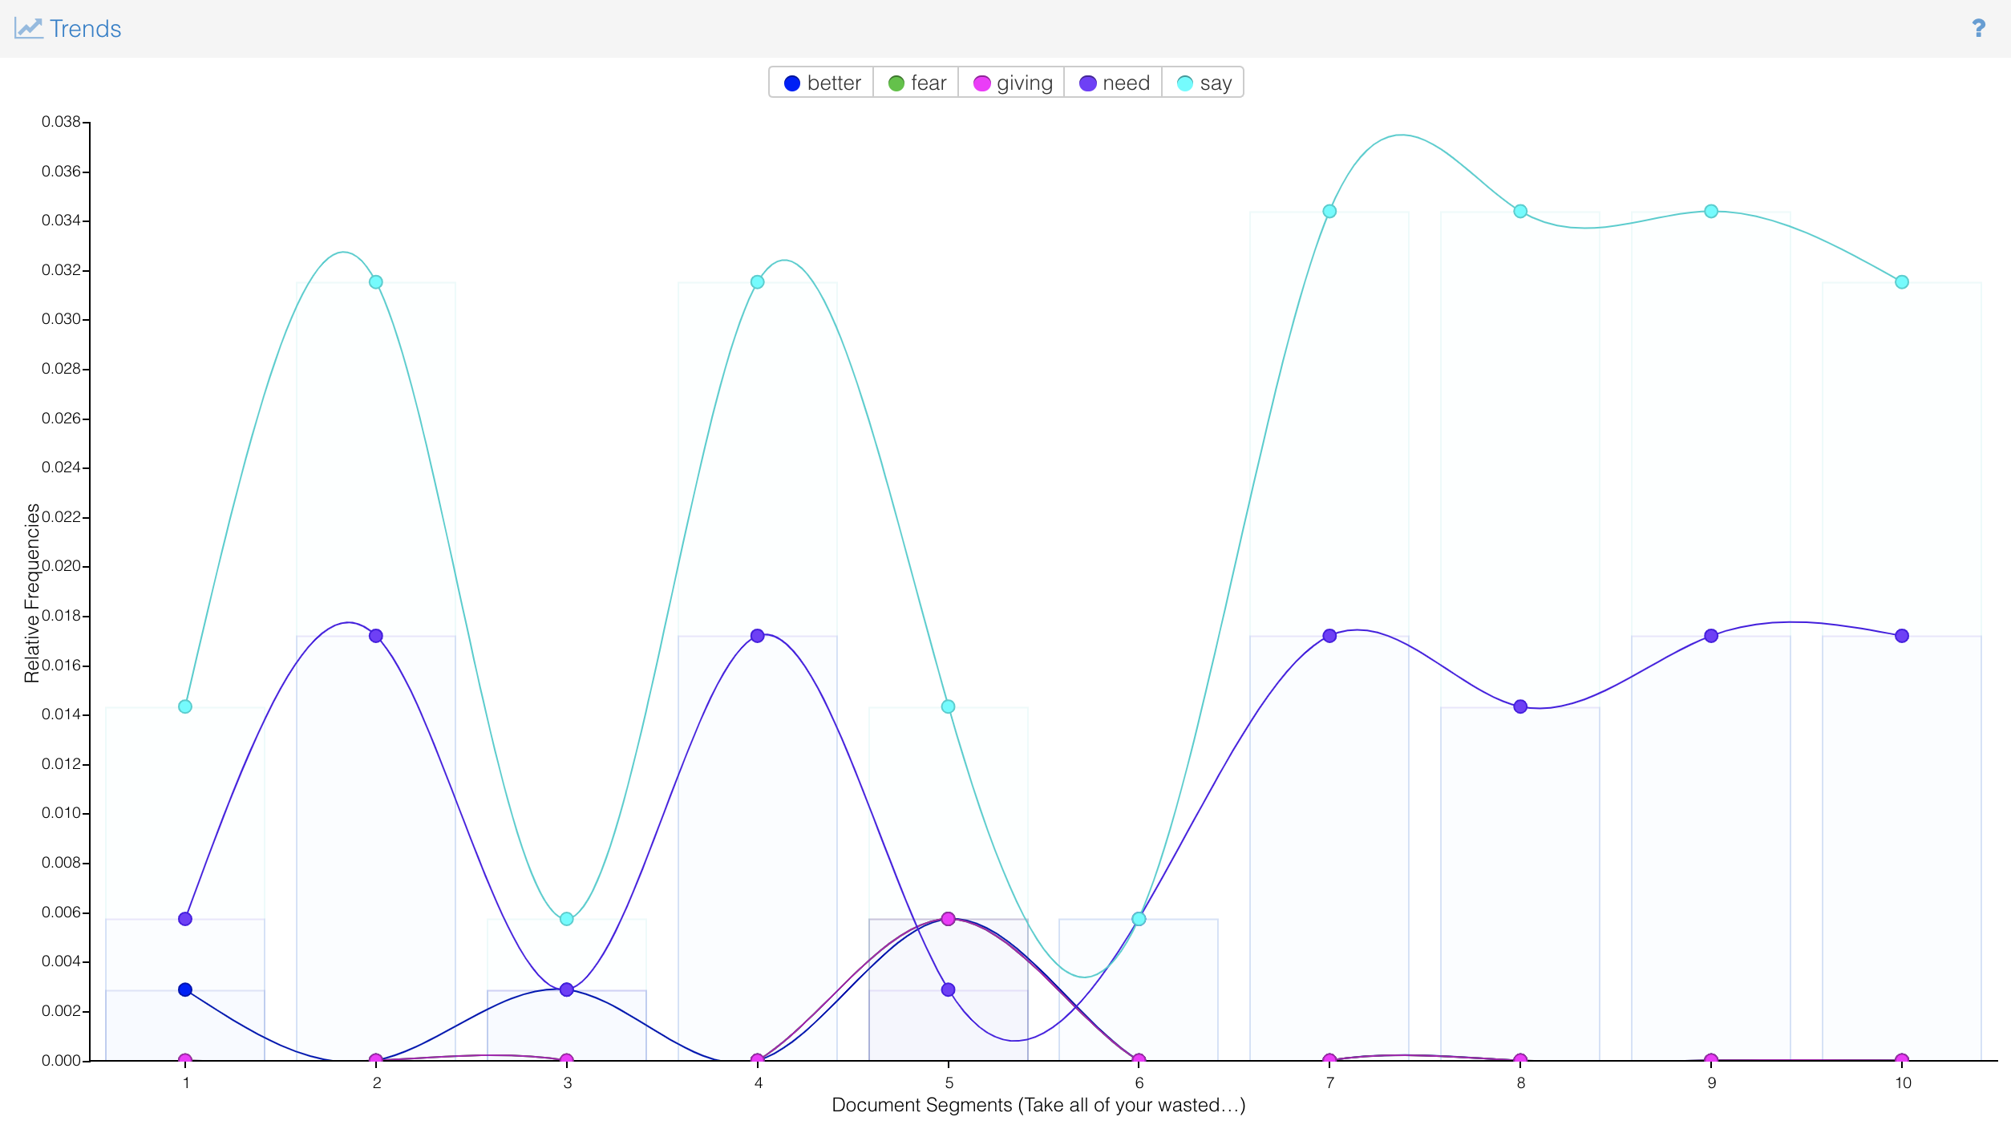
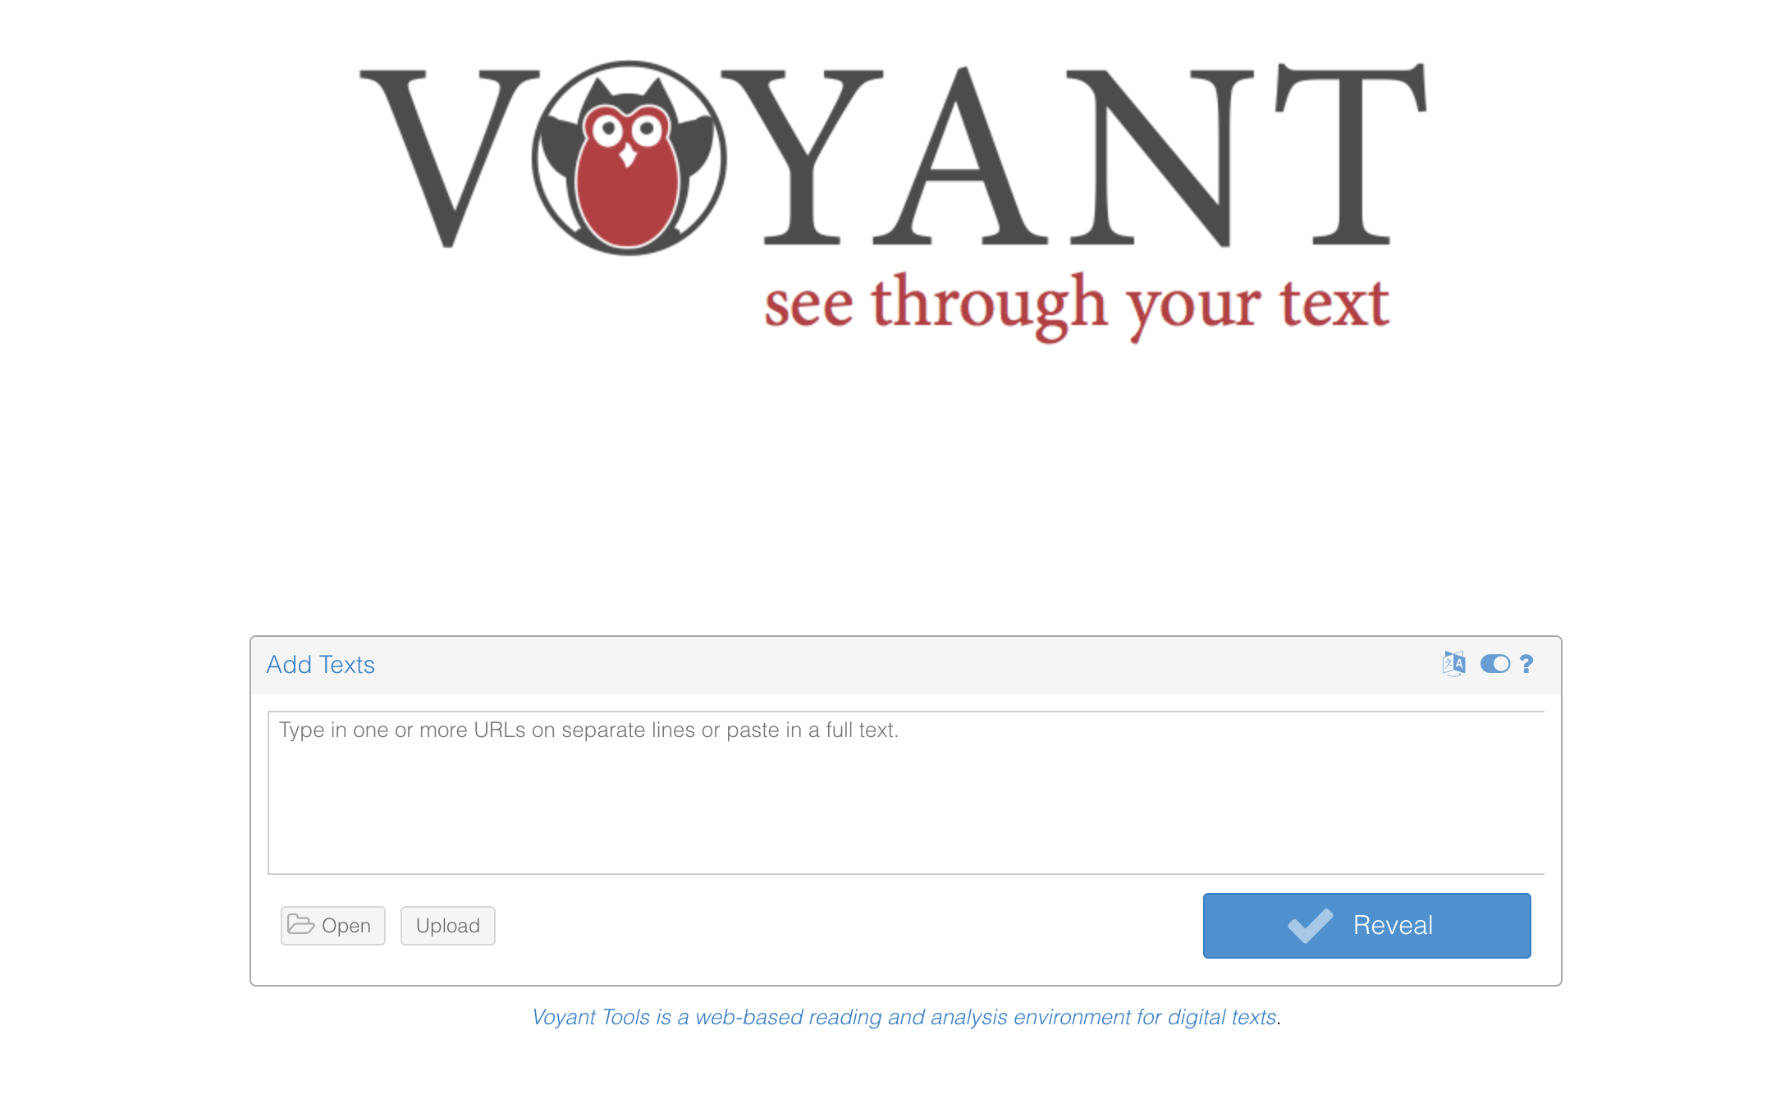
Say What
You Need
To Say:

Slide 14
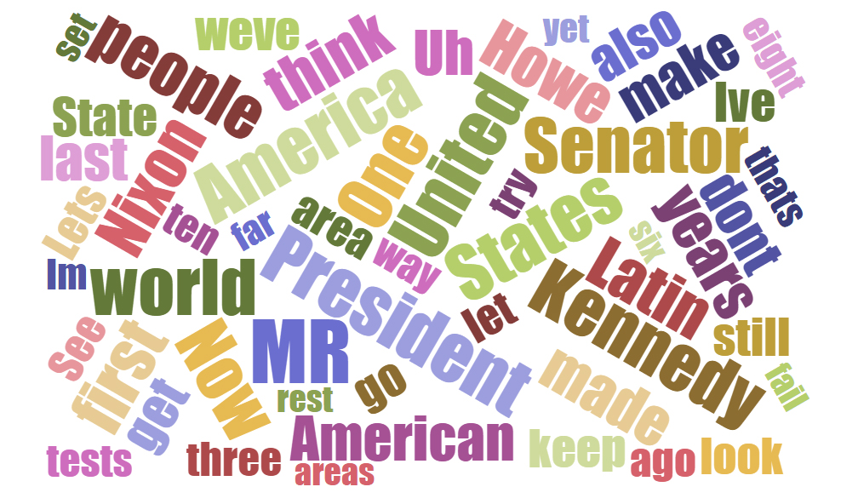
Treebanking & textual analysis

Slide 15
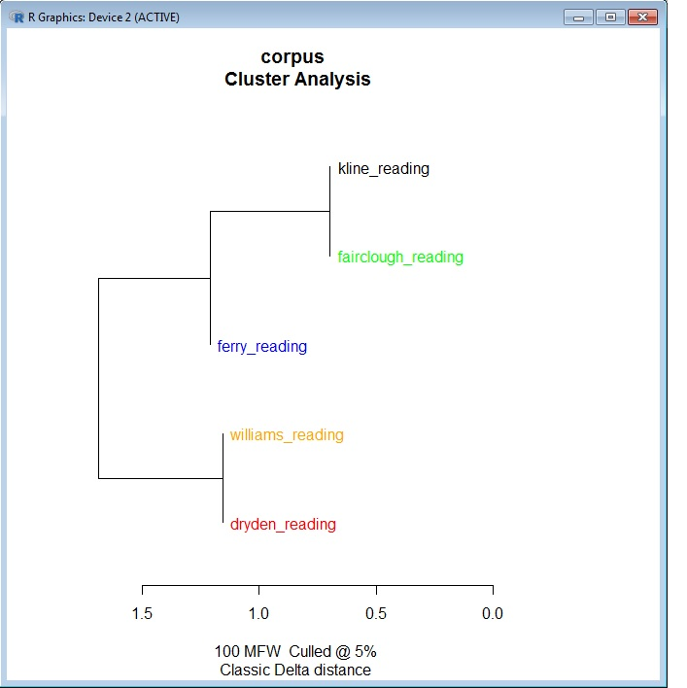
Translations “faithful” to the original

Slide 16
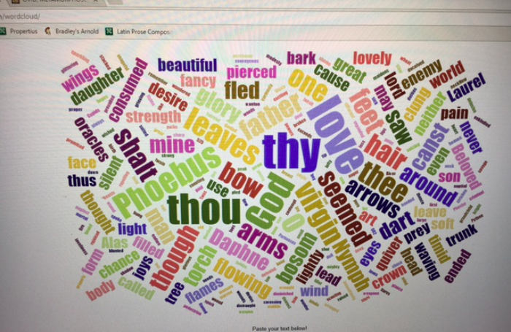
Classics & the #metoo movement

Slide 17
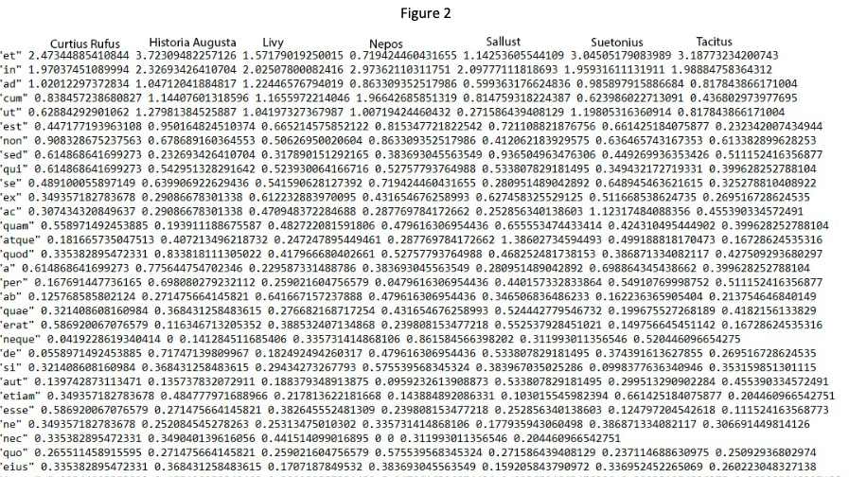
Livy, nepos, Sallust, Suetonius, tacitus, historia augusta
“This seems to show that as Latin aged the use of et rather than asyndeton or comparable conjunctions increased among prose authors. Some other notable discrepancies include; Sallust’s much rarer use of ut (explained by his regular use of quo to introduce a purpose clause), Tacitus’ high use of aut, and the Historia Augusta’s low use of quam."

Slide 18
Stylometry

Slide 19
history
Lorenzo da Valla in 1439
The Donation of Constantine (Latin: Donatio Constantini) is a forged Roman imperial decree by which the 4th century emperor Constantine the Great supposedly transferred authority over Rome and the western part of the Roman Empire to the Pope. Composed probably in the 8th century, it was used, especially in the 13th century, in support of claims of political authority by the papacy.
The basics of stylometry were set out by Polish philosopher Wincenty Lutosławski in Principes de stylométrie (1890)

Slide 20
References-Case Studies
Authorship of Ronald Reagan’s Radio Addresses
“Double Falsehood”

Slide 21
Tools for Stylometry
The Style of Numbers behind a Number of Styles
Making Hit Music into Science
Forensic Linguistics
Forensic Analysis of Instant Messaging
Deception in Instant Messaging

Slide 22
Stylometric parameters
Writer Invariant
Property of a text that is invariant of its authors
Word Lengths
Sentence Length
Average Word Length
Noun, Verb or adverb usage frequency
Vocabulary Richness
Frequency of Function Words

Slide 23

methodologies
Neural Networks (70% of precision)
Genetic Algorithms
Rare Pairs (based on collocation)

Slide 24
Software for stylometry
JAVA Graphical Authorship Attribution program
The Signature Stylometric System
Stylene (a stylometric system for Dutch)
Stylo

Slide 25
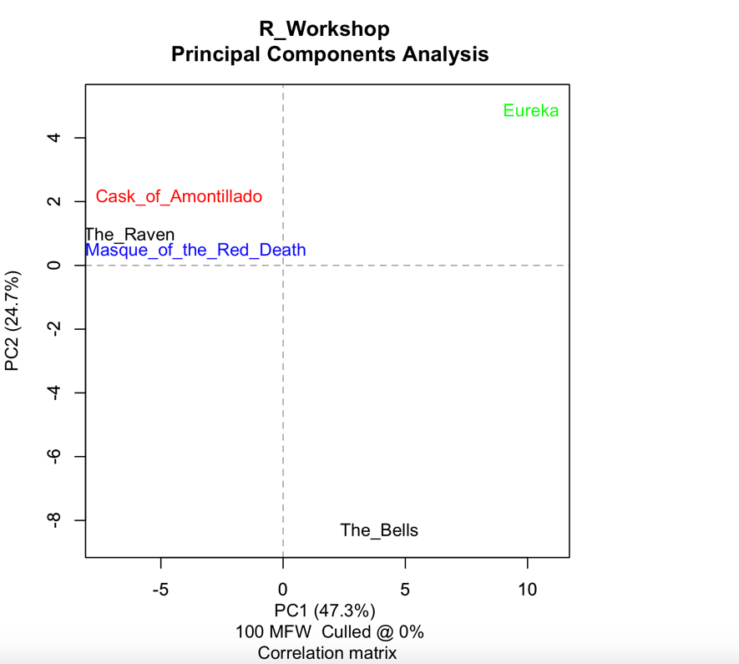
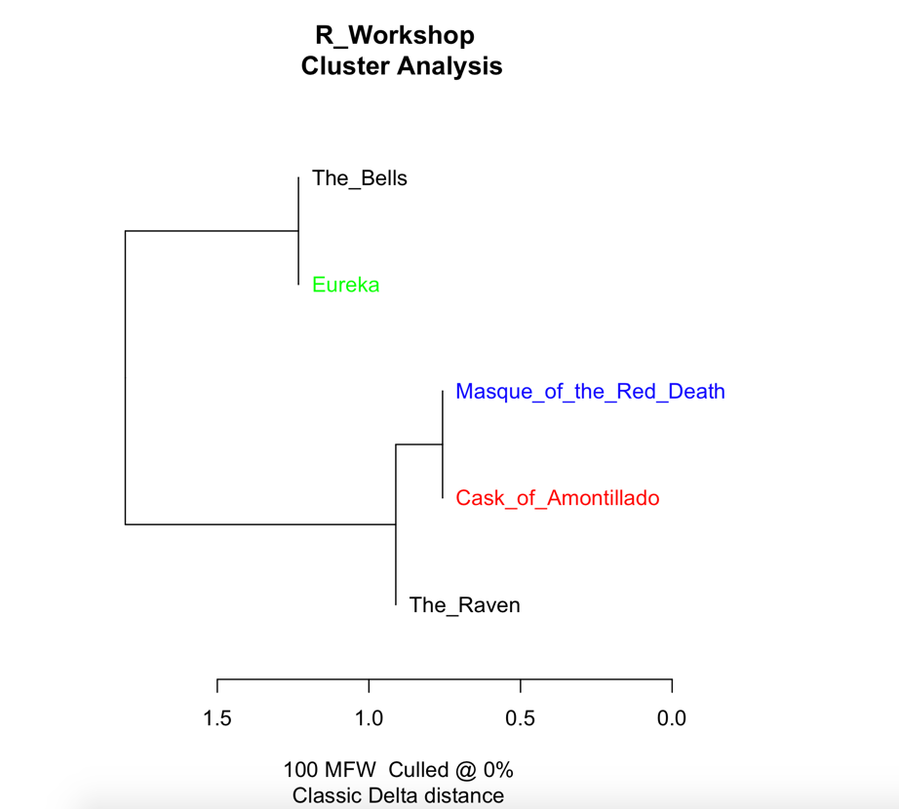
Edgar Allan Poe

Slide 26
Stylo
Instructions: How to set up R and stylo
R is a programming environment for computations, analysis, and statistics of data. It provides functions to parse data, store them as variables or arrays, and perform calculations.
Download R for your operating system
https://cran.cnr.berkeley.edu/
If you use Mac, you need also the following
http://www.xquartz.org/
Open R and type
install.packages("stylo”)
Activate the package (whenever you start a fresh R session):

Slide 27
Stylo
library(stylo)
A manual to stylometry using "stylo" is available here.
Setting working Directory
1) through the menu
In Windows: go to the File menu, select Change Working Directory, and select the appropriate folder/directory
In Macs: go to the Misc menu, select Change Working Directory, and select the appropriate folder/directory

Slide 28
Stylo
Inside your Working Directory create a folder “corpus”
In the “corpus” folder create at least 2 text files with the documents you want to analyze.
In Windows, open Notepad
In Mac, open text edit
Go to text edit preferences and make sure “plain text” is selected under new document tab.
Create a new document and paste some content.

Slide 29
A language is not just words. It's a culture, a tradition, a unification of a community, a whole history that creates what a community is. It's all embodied in a language.
Noam Chomsky

Slide 30
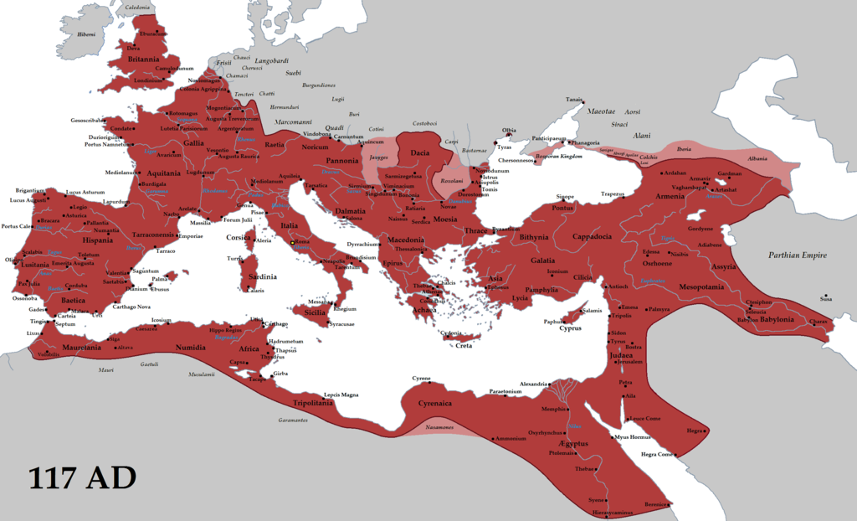
Kulturgrenzen vs . Landesgrenzen

Slide 31
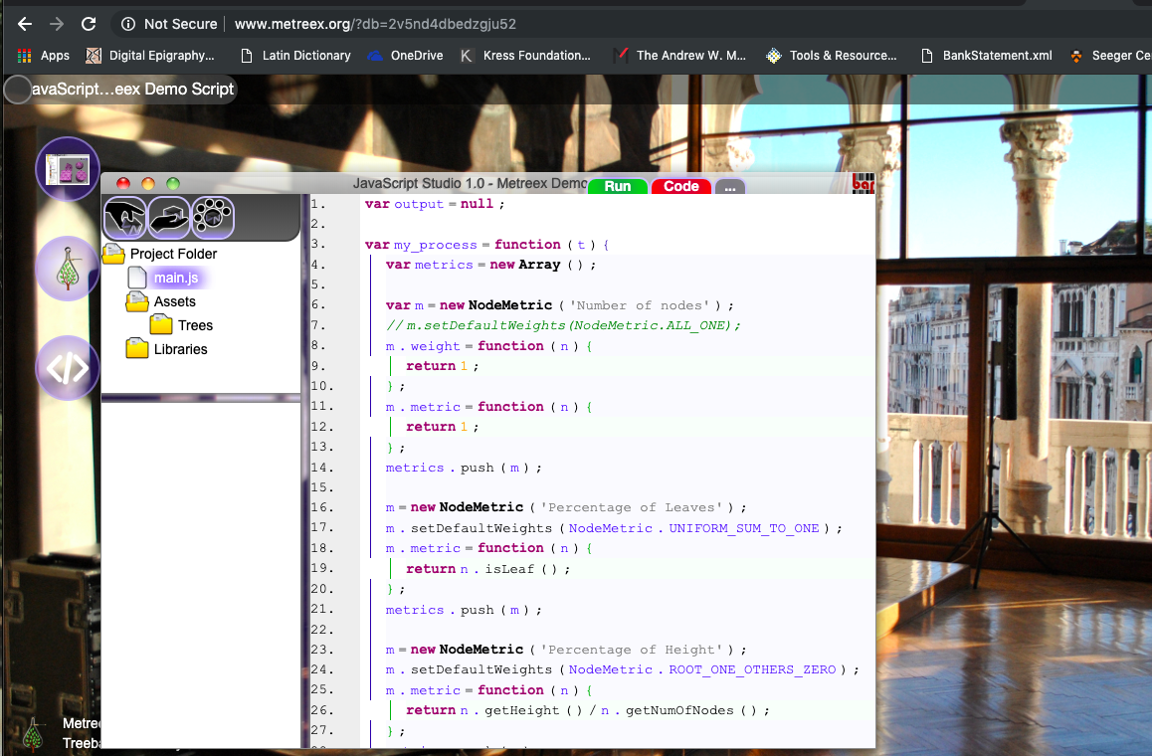
Customized metrics
www.metreex.org

Slide 32
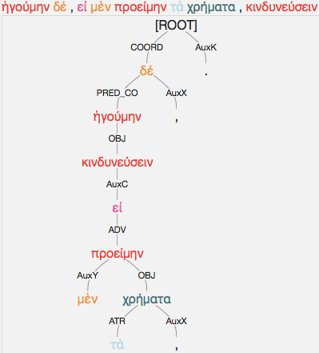
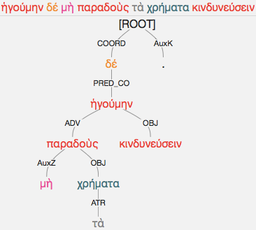
www.perseids.org

Slide 33
synopsis
1. Definitions of Hellenism and Atticism
2. Computational analysis and quantification of Atticism
3. Philological readings of the numeric results and socio-cultural interpretations

Slide 34
Greek & Attic: language(s) or culture(s)
Speech is then constructed of these; for the beginning of the word is speaking proper Greek. (Arist. Rhet. 1407a.19-1407a.20)
There is one Hellas, but many cities: you speak Attic, whenever you utter a phrase, some of you there, but we Hellenes speak Hellenic. Why do you, occupying yourself with syllables. and letters, drag your lively wit into unpleasantness? (Posidippus fr. 28)

Slide 35
Greek & attic: language(s) or culture(s)
Attic writers [write] deiknusi [“they demonstrate”] with a contraction; Hellenes deiknuesin. And the secondary Attic writers [write] deinuasi. (Moeris 194.29)
Attic speakers [write] zeugnusin [“they join”] in the plural with a contraction; Hellenes [write] zeugnuesin. And it is zeugnuasin in secondary Attic. (Moeris 197.28)
pluneis [“clothes-cleaners”] in primary Attic, knapheis in secondary Attic. (Moeris 208.15)

Slide 36
Greek & latin: languages or cultures
kakodaimonein [“to be unhappy”]: this is how fake Atticizers speakers use the word, for Athenians says kakodaimonan, on account of the alpha. (Phrynichus 54)

Slide 37
Dionysius Halicarnassus
We ought to acknowledge a great debt of gratitude to the age in which we live, my most accomplished Ammaeus, for an improvement in certain fields of serious study, and especially for the considerable revival in the practice of civil oratory. In the epoch preceding our own, the old philosophic Rhetoric was so grossly abused and maltreated that it fell into a decline. From the death of Alexander of Macedon it began to lose its spirit and gradually wither away, and in our generation had reached a state of almost total extinction… I think that the cause and origin of this great revolution has been the conquest of the world by Rome, who has thus made every city focus its entire attention upon her. (Dion. Hal. Orat.Vett. 1-3. Trans. Usher)

Slide 38
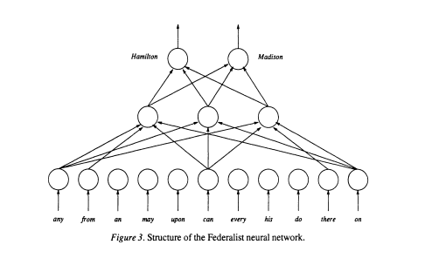
Federalist papers
Tweedie, F., Singh, S., & Holmes, D. (1996). Neural Network Applications in Stylometry: The "Federalist Papers". Computers and the Humanities, 30(1), 1-10. Retrieved from http://www.jstor.org/stable/30204514

Slide 39
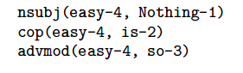
Computational Syntactical analysis
Hollingsworth, C. (2014). “Using Dependency-Based Annotations for Authority Identification.” In Sojka, P. (2014). Text, speech and dialogue : 17th International Conference, TSD 2014, Brno, Czech Republic, September 8-12, 2014. Proceedings. Cham : Springer, 2014.

Slide 40
Dionysius, Lysias
He is completely pure in his vocabulary, and is the perfect model of the Attic dialect (Dionysius of Halicarnassus, Lysias 2)
Purity of language, correct dialect, the presentation of ideas by means of standard, not figurative expressions; Clarity, brevity, concision, terseness, vivid representation…But there is nothing sublime or imposing about the style of Lysias. It certainly does not excite us or move us to wonder, nor does it portray pungency , intensity or fear; (Dionysius of Halicarnassus, Lysias 13)

Slide 41
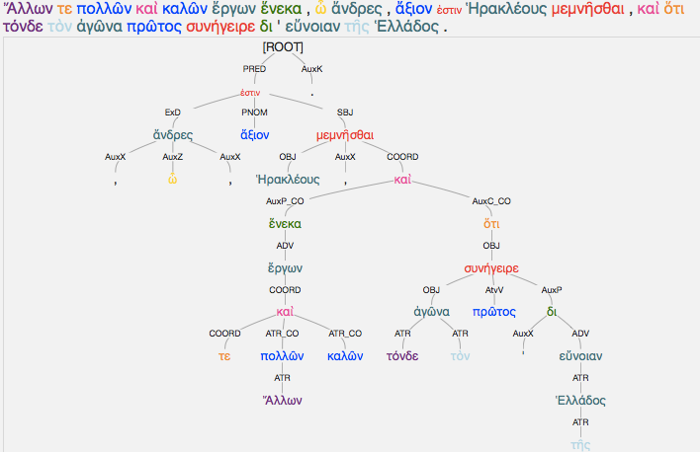
Lysias, olympiakus 1

Slide 42
His style has the following characteristics: it is as pure as that of Lysias; Not a word is used at random; And the language comforms closely to the most ordinary and familiar usage. Like its predecessor, it avoids the banality of archaic and obscure words, but uses figurative language somewhat more than Lysias, achieving a happy balance in this respect. In the matter of lucidity and vividness it is similar to that of Lysias; (Dionysius of Halicarnassus, Isocrates 2)

Slide 43
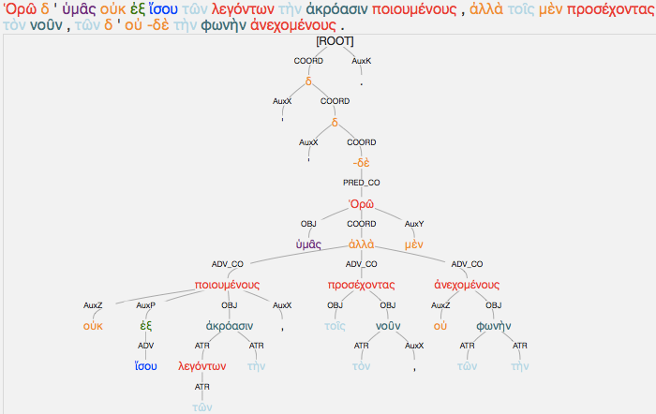
Isocrates, Panegyricus 1

Slide 44
Isocrates and his rewrites

Slide 45
Dionysius, Demosthenes
In the first place, before rounding off the first idea (or clause if it should be called), a second idea is introduced; then a third is subjoined before the second is complete, and material belonging to the second is tacked on after the third has been completed. (Dionysius, Demosthenes 9)

Slide 46
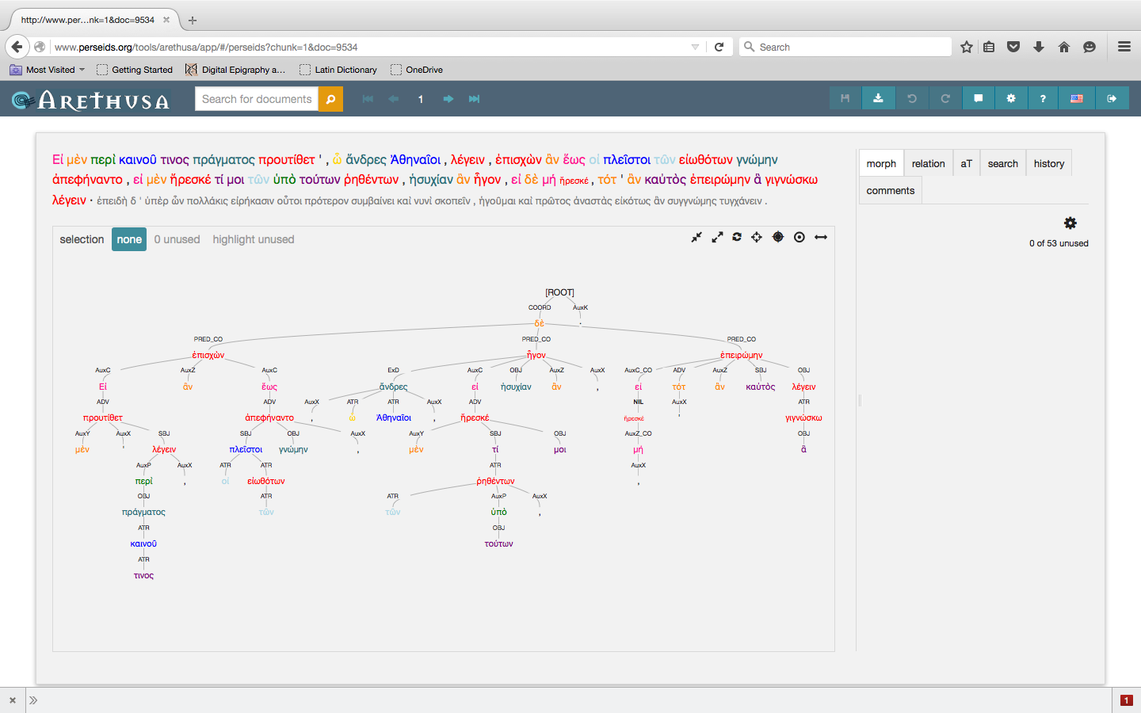
Demosthenes, philippic 1.1

Slide 47
Coming to make you my morning salutation, which should have taken the orthodox form of Rejoice, I bade you, in a very choice fit of absent-mindedness, Be healthy—a good enough wish in its way, but a little untimely and unconnected with that early hour. (Luc. Laps. 1.)

Slide 48
To be honest, however, their praise caused me considerable annoyance, and when they had gone and I was left alone, I reflected as follows: “So this is the only attraction in my writings, that they are unconventional and keep off the beaten track. While good vocabulary, conformity to the ancient canon, penetration of intellect, power of perception, Attic grace, good construction, general competence, perhaps have no place in my work. (Lucian, Zeuxis 2)

Slide 49
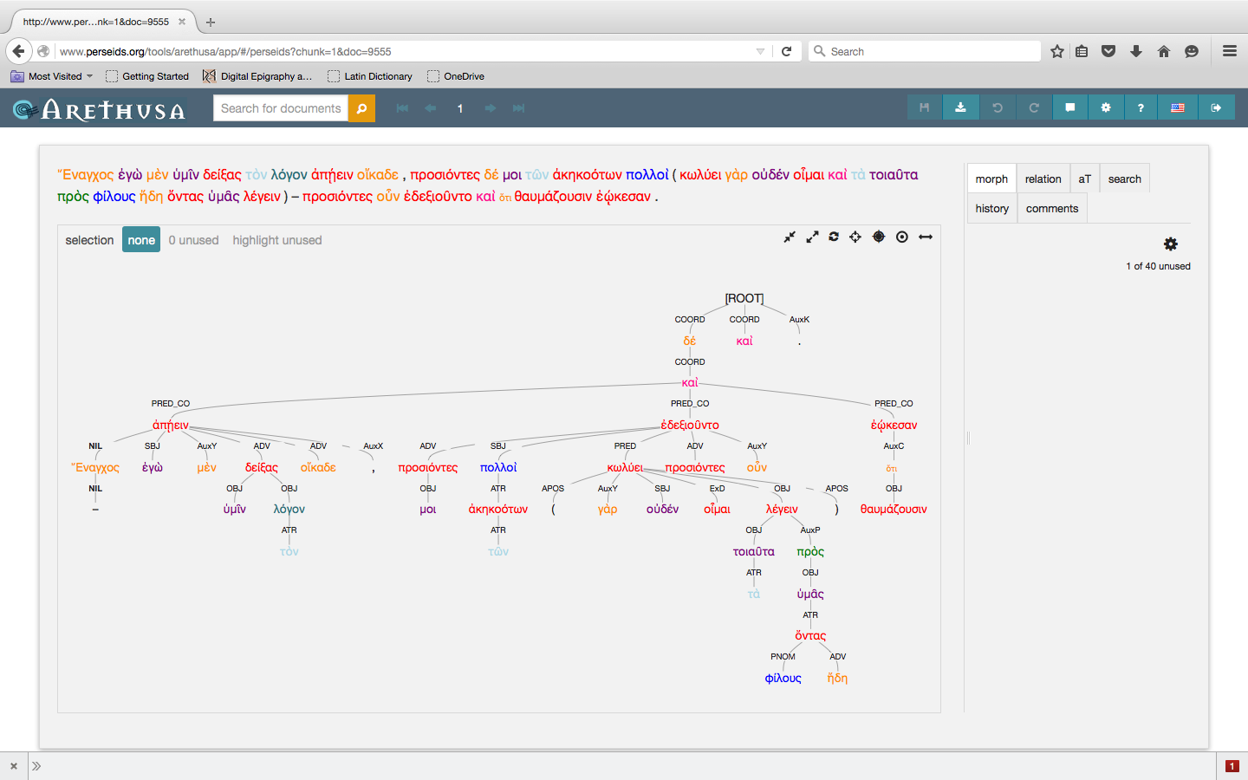
Lucian, Zeuxis 1

Slide 50
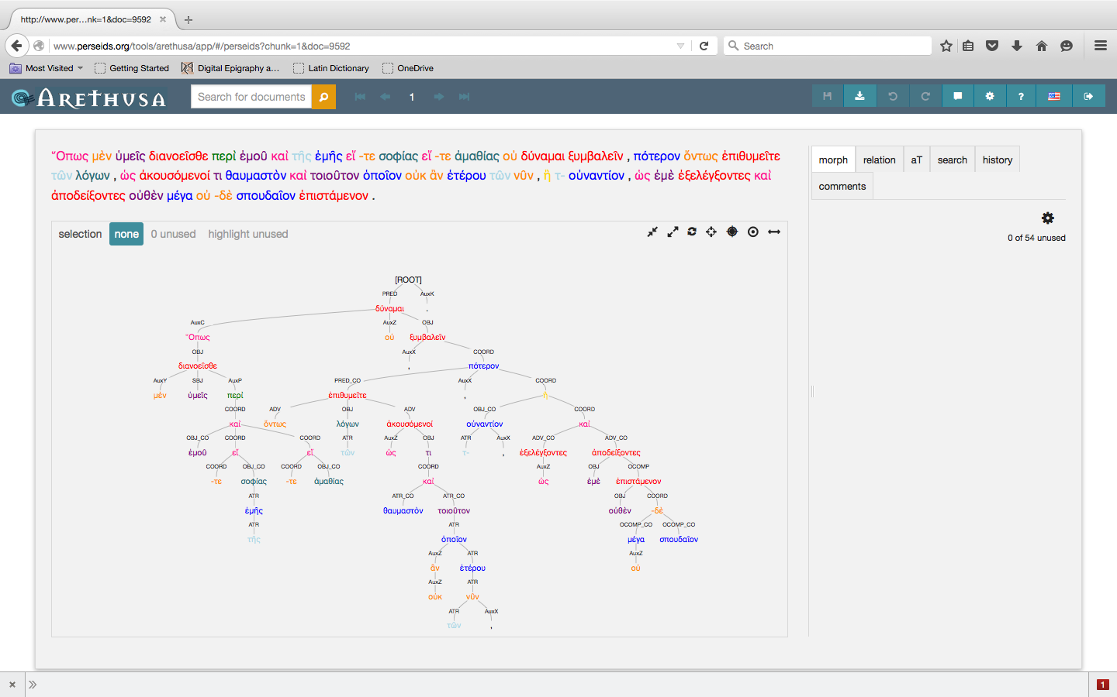
Dio, Oratio 42.1

Slide 51
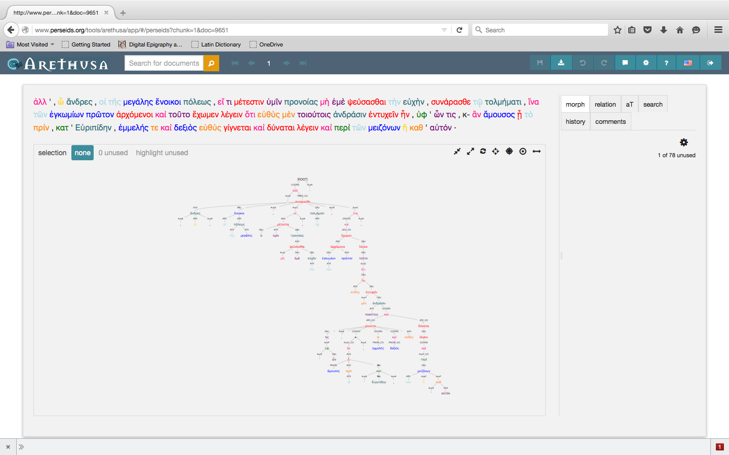
Aelius Aristides, ROme

Slide 52
Sentence as a tree
S={n₁, n₂, n₃, … n_{k}}
where n_{i} is a tree node (n_{i} ϵ T)
and T denotes the space of tree nodes
Each node is a tree on its own
Each node has properties such as:
children of: T→ {Ø,T, T², … ,T^{k-1}}
isATR: T→{0,1}

Slide 53
Node-Based metrics
Let’s consider this example syntactically annotated sentence:

Slide 54
Node-Based metrics
To calculate a sentence metric we need: w and μ
Weights
Metric Values
w₄
μ₄
w₂
w₇
μ₂
μ₇
w₁
w₃
w₅
μ₁
μ₃
μ₅
w₆
μ₆
Result: w₁×μ₁+w₂×μ₂+w₃×μ₃+w₄×μ₄+w₅×μ₅+w₆×μ₆+w₇×μ₇

Slide 55
Node-Based metrics
Metric example: Number of words
Weights
Metric Values
1
1
1
1
1
1
1
1
1
1
1
1
1
1
Result: 1×1+1×1+1×1+1×1+1×1+1×1+1×1=7

Slide 56
Node-Based metrics
Metric example: Number of attributives
Weights
Metric Values
1
0
1
1
0
0
ATR
1
1
1
0
1
0
ATR
1
1
Result: 1×0+1×0+1×1+1×0+1×1+1×0+1×0=2

Slide 57
Node-Based metrics
Metric example: Percentage of leaves
Weights
Metric Values
1/7
0
1/7
1/7
0
1
1/7
1/7
1/7
1
1
0
1/7
1
Result: 1/7×0+1/7×1+1/7×1+1/7×0+1/7×1+1/7×1+1/7×0=4/7

Slide 58
Node-Based metrics
Metric example: Percentage of attributives
Weights
Metric Values
1/7
0
1/7
1/7
0
0
ATR
1/7
1/7
1/7
0
1
0
ATR
1/7
1
Result: 1/7×0+1/7×0+1/7×1+1/7×0+1/7×1+1/7×0+1/7×0=2/7

Slide 59
Recursive Node-Based metrics
Metric example: Height of the tree
Weights
Metric Values
1
4
0
0
3
1
0
0
0
1
1
2
0
1
Result: 1×4+0×3+0×1+0×1+0×1+0×2+0×1=4

Slide 60
Recursive Node-Based metrics
Metric example: Height of the tree as percentage of the words
Weights
Metric Values
1/7
4
0
0
3
1
0
0
0
1
1
2
0
1
Result: 1/7×4+0×3+0×1+0×1+0×1+0×2+0×1=4/7

Slide 61
Recursive Node-Based metrics
Metric example: Size of largest family
Weights
Metric Values
1
3
0
0
3
0
0
0
0
0
0
1
0
0
Result: 1×3+0×3+0×0+0×0+0×0+0×1+0×0=3

Slide 62
Recursive Node-Based metrics
Metric example: Size of largest family as percentage of the words
Weights
Metric Values
1/7
3
0
0
3
0
0
0
0
0
0
1
0
0
Result: 1/7×3+0×3+0×0+0×0+0×0+0×1+0×0=3/7

Slide 63
Javascript
m=new NodeMetric('Percentage of Verb Attributives');
m.weight=function(n)
{
return 1/n.getRoot().getNumOfWords();
};
m.metric=function(n)
{
if(n.getRelation()=='ATR’ && n.getPosTag()[0]=='v')
return 1;
else return 0;
};

Slide 64
metrics
Height of the tree as percentage of the nodes
Width of the tree as percentage of the nodes
Number of leaves as percentage of the nodes
Number of attributives as percentage of the nodes
Largest family size as percentage of the nodes
Verb Attributives as percentage of the nodes
Percentage of δέ coordinates
Number of nodes under ATR as percentage of the nodes
Adjective Attributives as percentage of the nodes

Slide 65
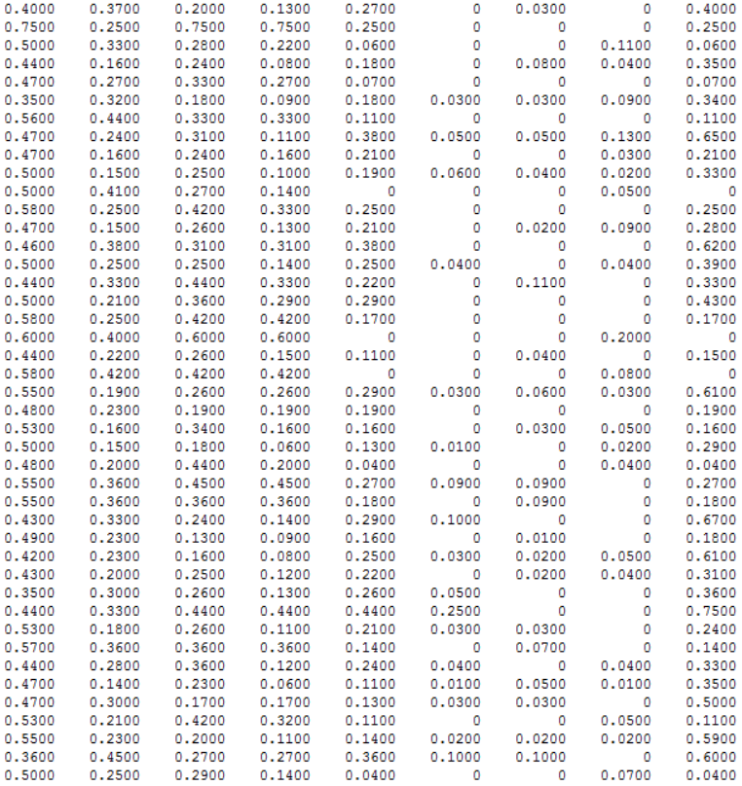
SAMPLE DATA
Height Width Leaves ATR Family VATR de UATR AATR

Slide 66
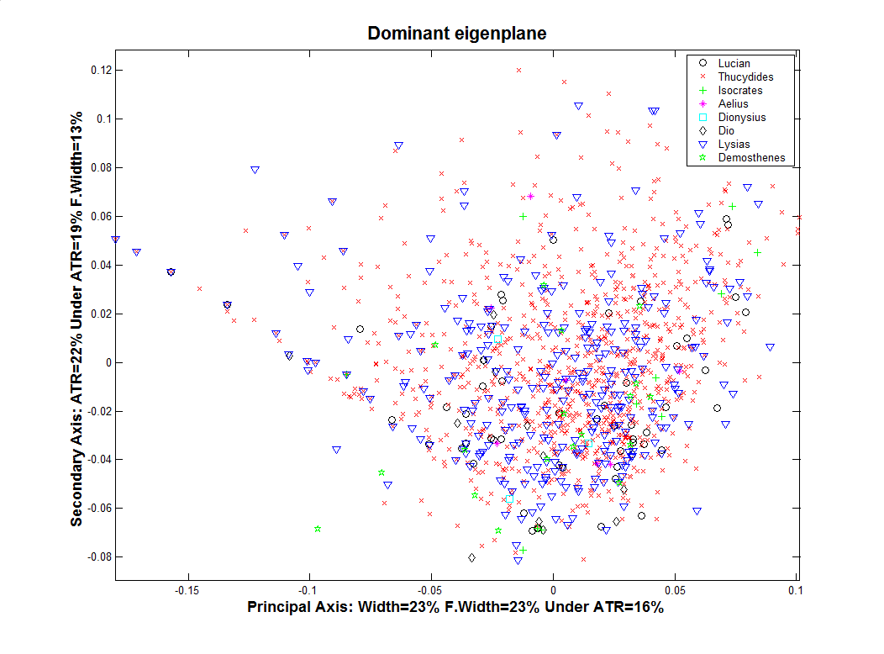

Slide 67
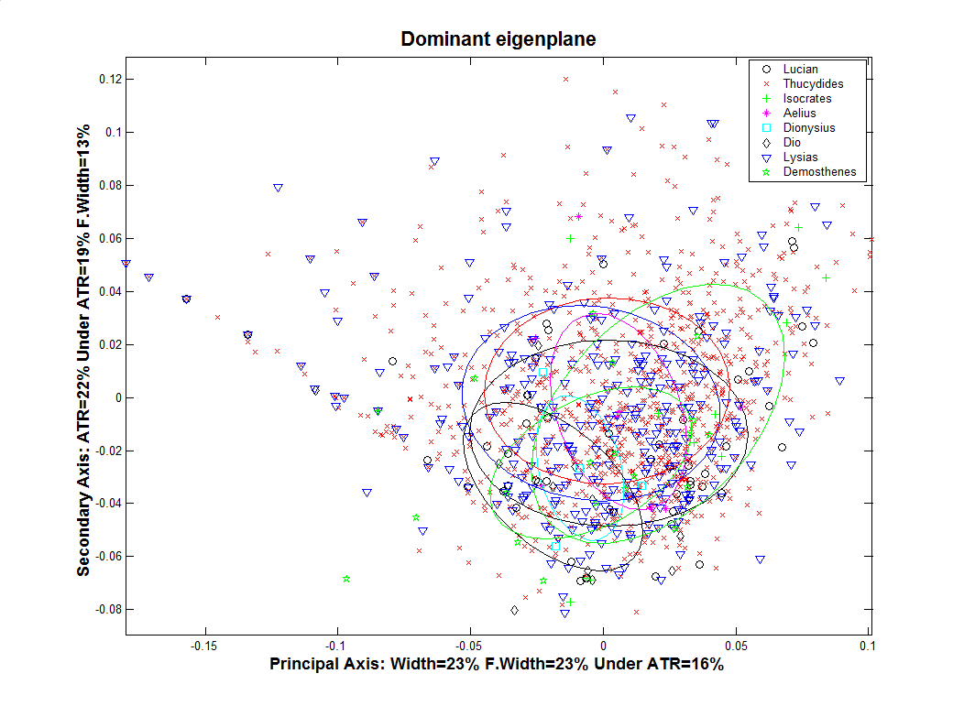

Slide 68
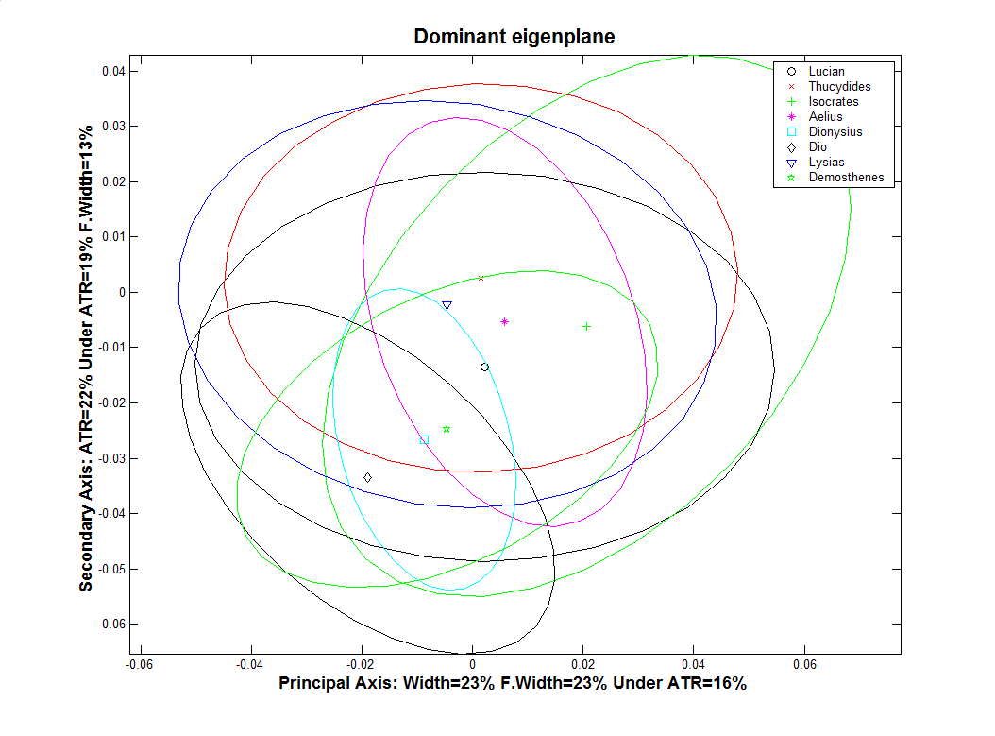

Slide 69
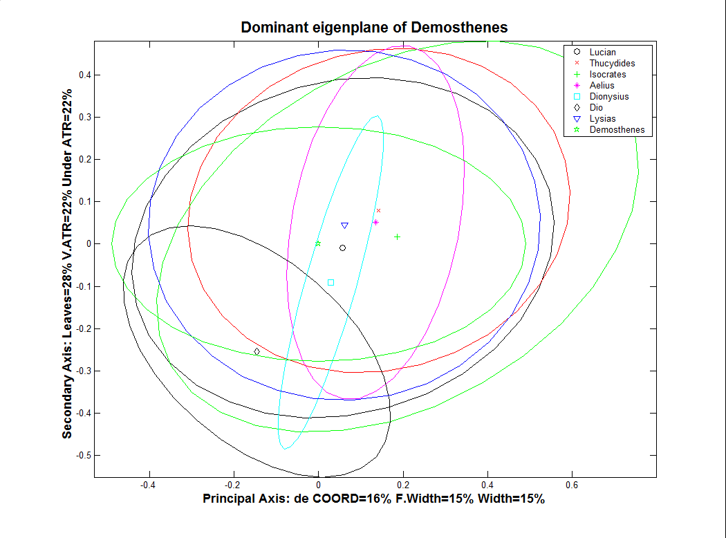

Slide 70
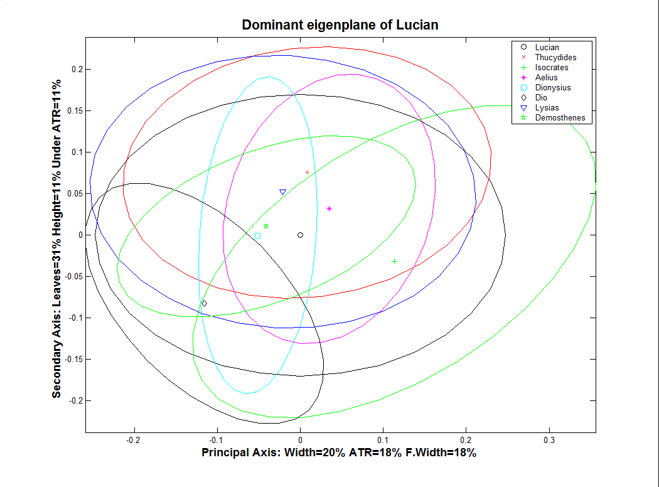

Slide 72
Dionysius through Wavelets
He is therefore compelled to pad his sentences with words that contribute nothing, and to extend his speech beyond its effective length. I do not mean to imply that he invariably does this (I am not so mad as to do that: for there are times, especially in his political and forensic speeches, when he tastefully relieves the periodic structure and avoids the excessive and vulgar use of figures, and composes in plain style). (D.H. Isoc. 3)

Slide 73
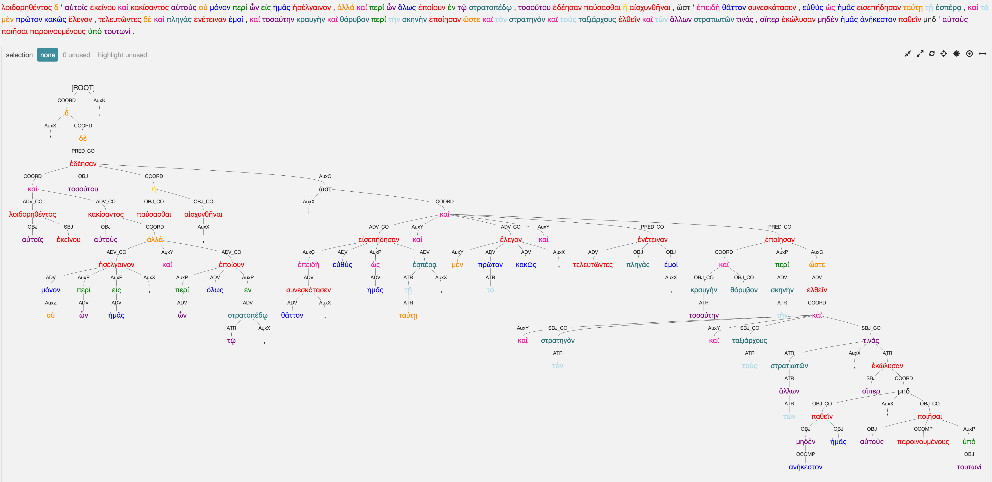
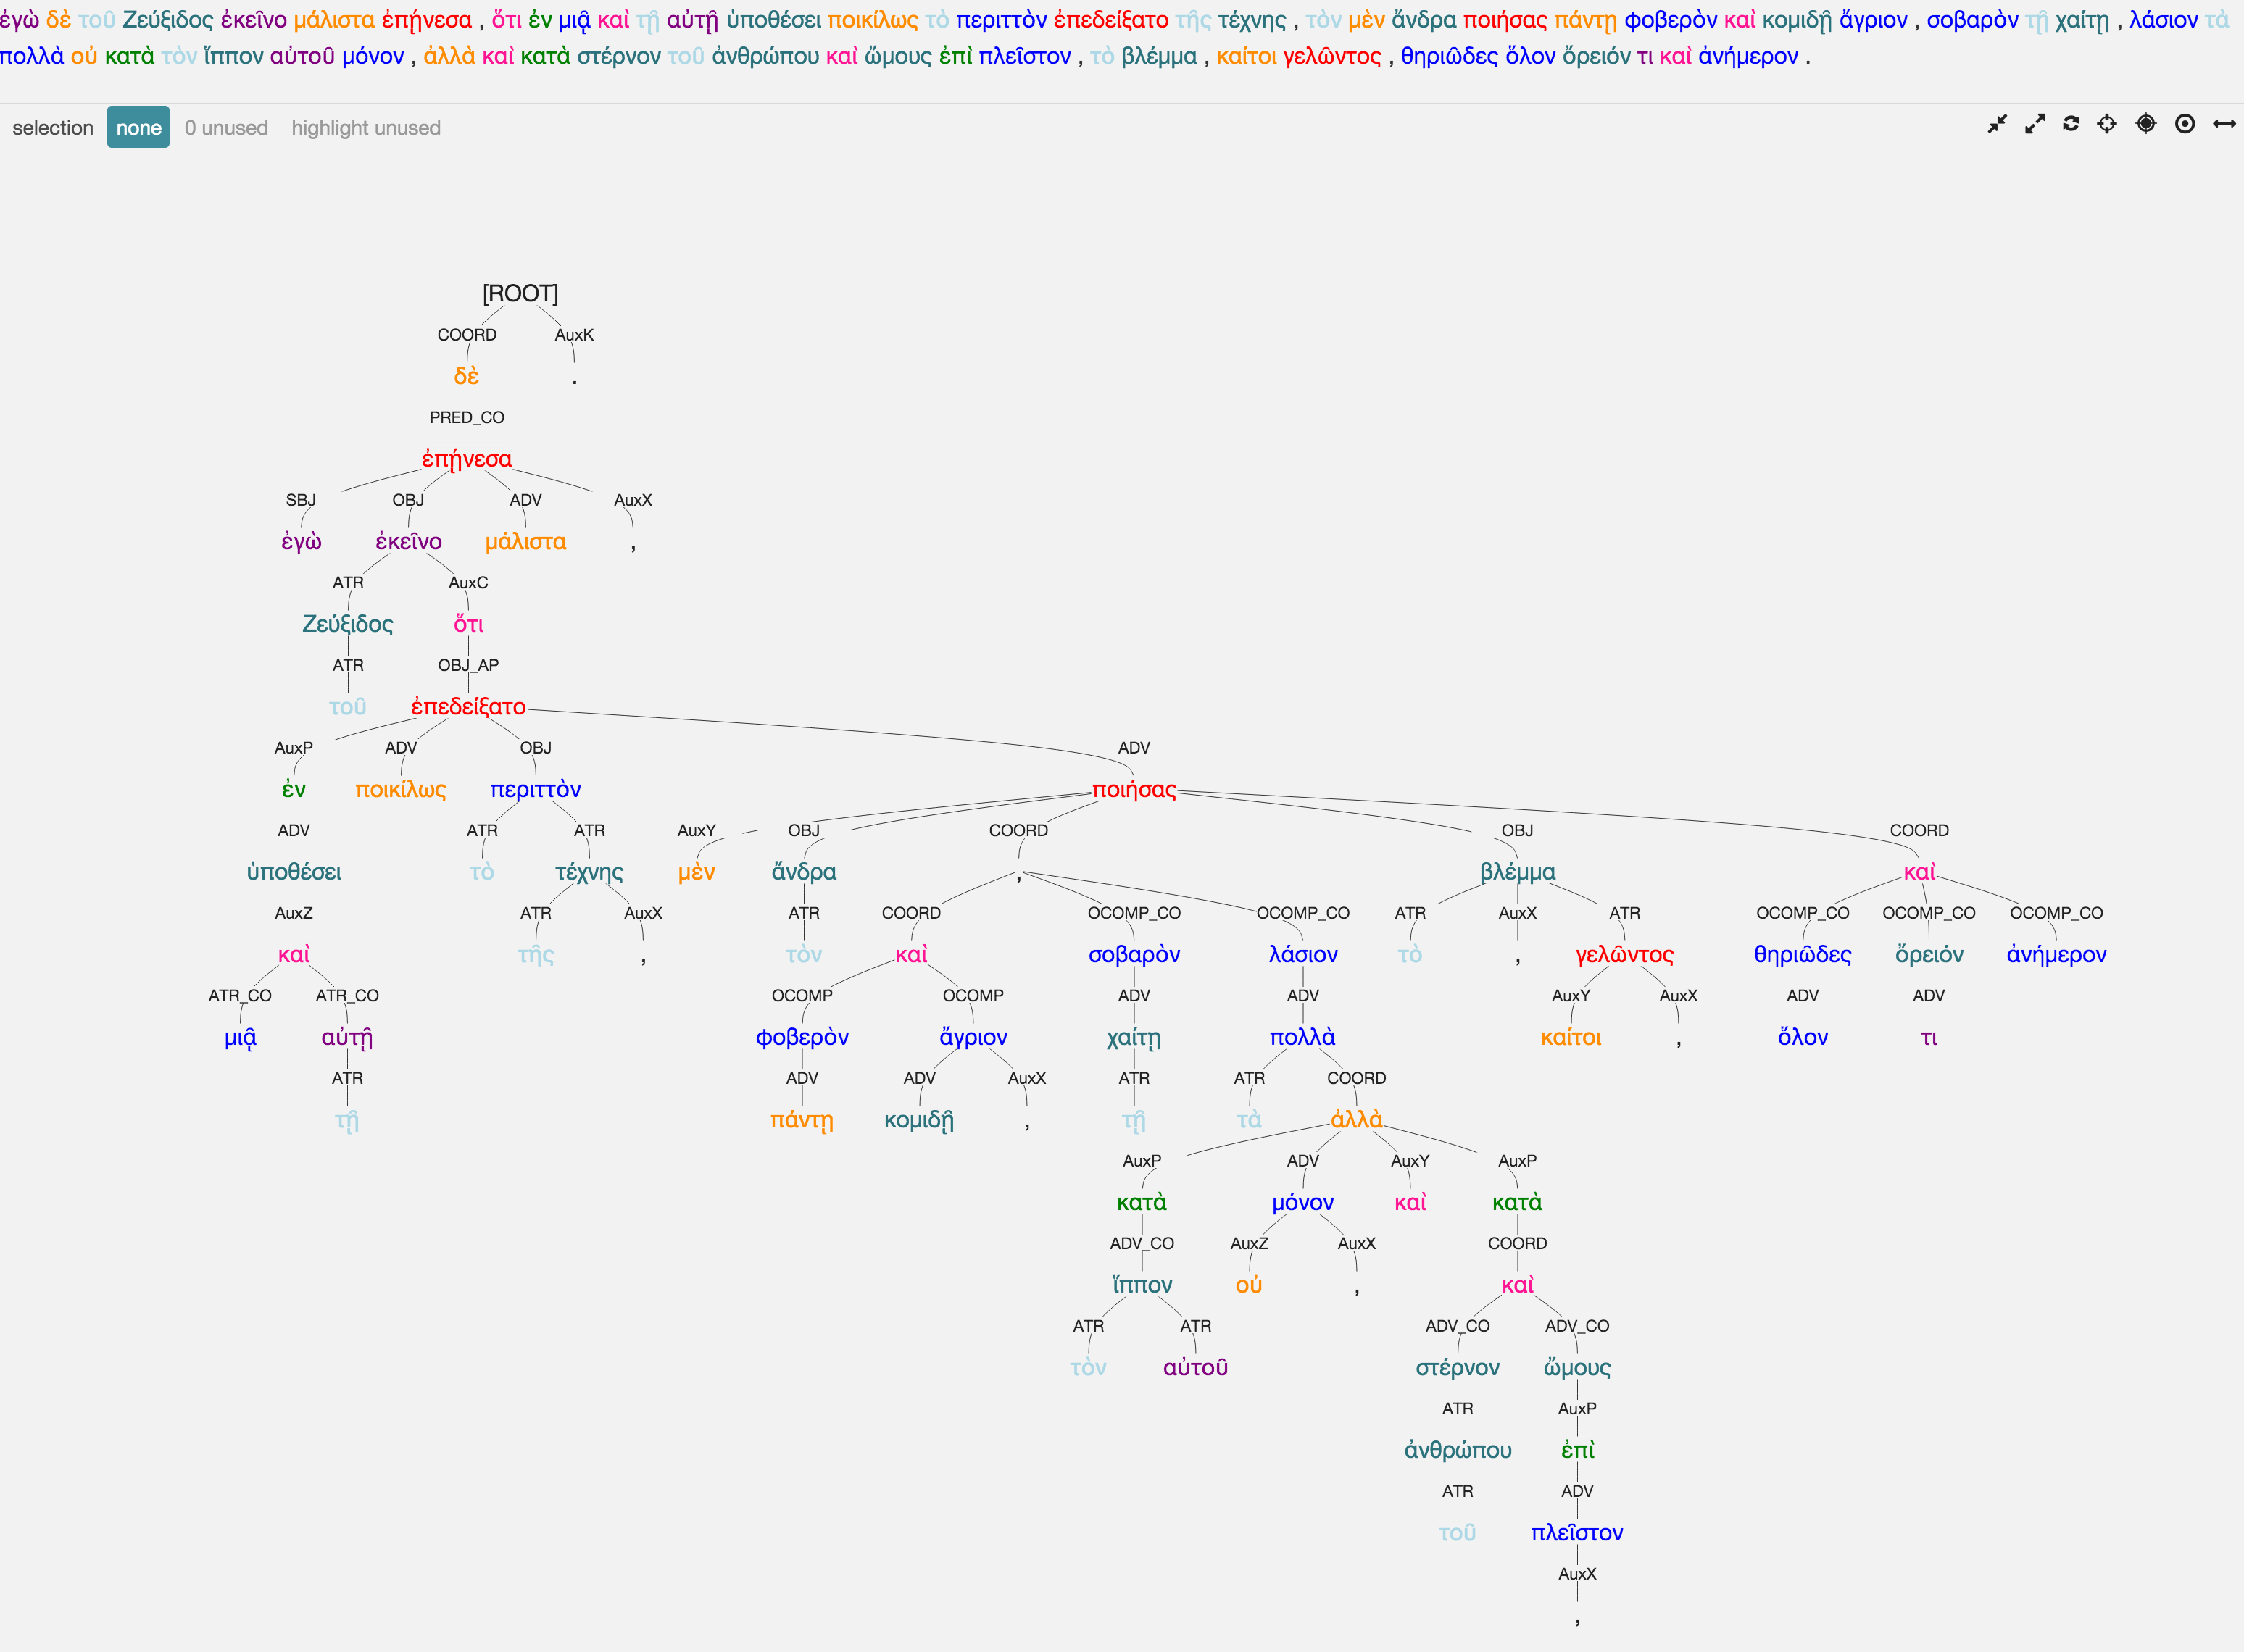
Analysis
Demosthenes, Against Conon 1
Lucian, Zeuxis 1

Slide 74
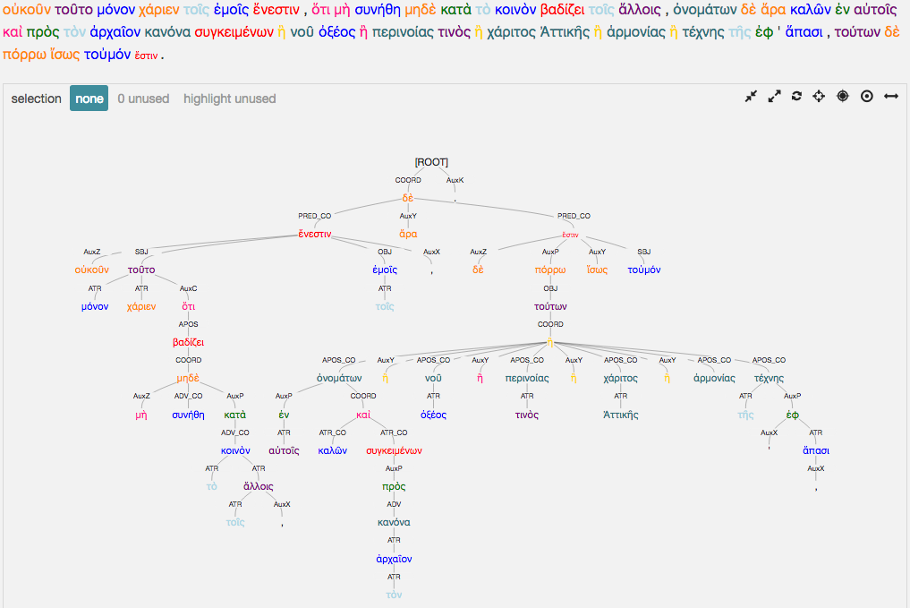
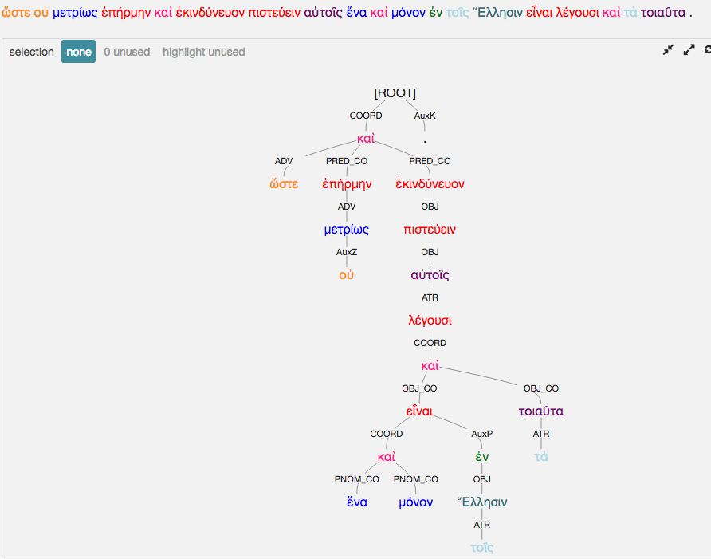
analysis
Lucian, Zeuxis 1
Lucian, Zeuxis 2

Slide 75
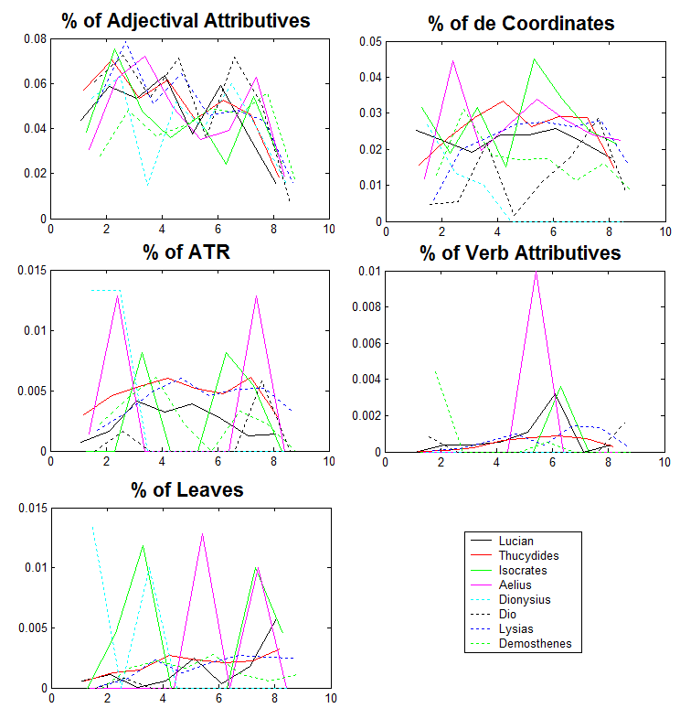
wavelets
Plots of the average local variations of each metric along the sentence as calculated from the wavelet metrics.

Slide 76
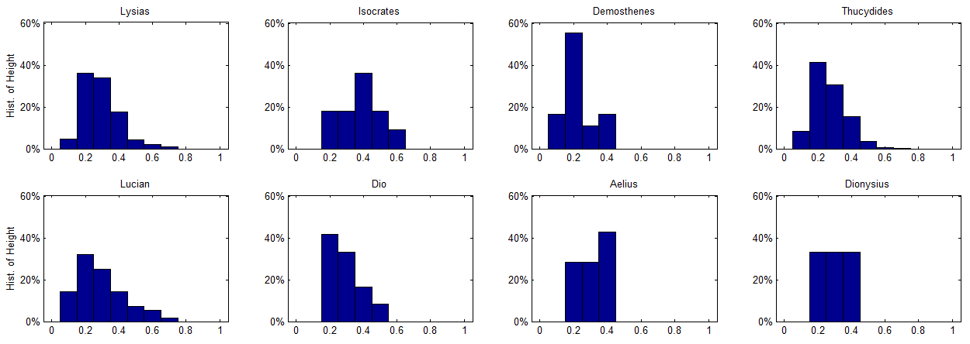
Analysis
This figure shows histograms of height as percentage of the nodes.

Slide 80
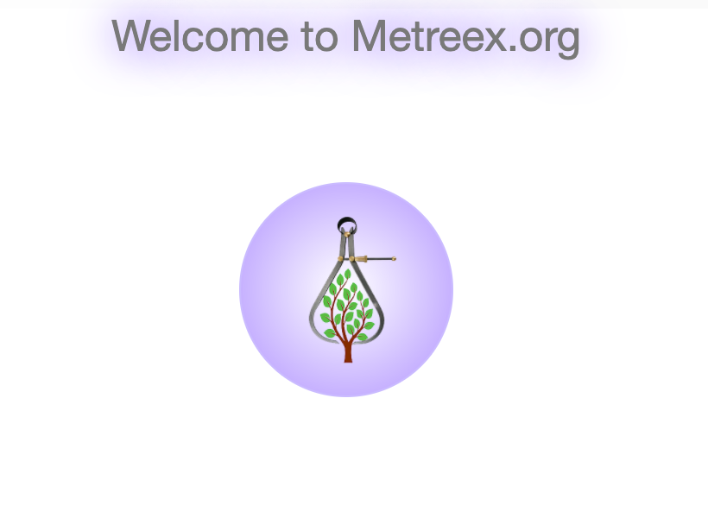

Slide 81
Thank you!

